Slide 1
Testing Demo

Slide 2

Agenda
Why Testing?
Manual testing Approach
Automation testing Approach
Projects with Different Domains
Contents and Duration of the Course

Slide 3
Manual testing Approach
What is Manual testing?
Why Manual Testing?
Pros &Cons of Manual Testing

Slide 4
Types of applications
Web Applications
Desktop Applications
Mobile Applications

Slide 5
Automation testing Approach
What is Automation testing?
When we perform Automation Testing?
Pros &Cons of Automation Testing

Slide 6
What is Selenium
Eclipse IDE
Test management tools
Defect reporting tools

Slide 7
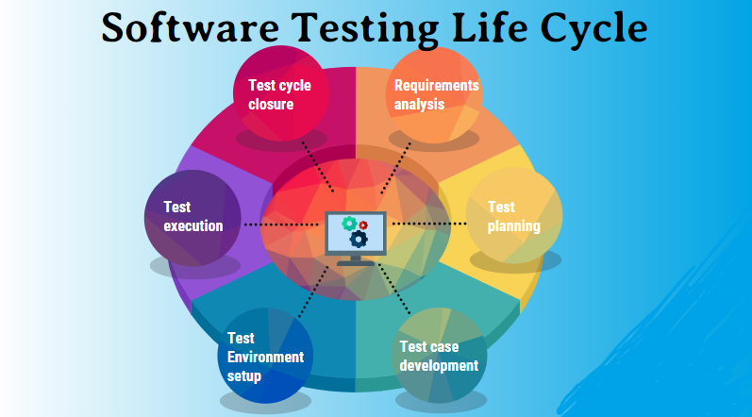
Software Testing Life Cycle
Requirement Analysis
Test Planning
Test Scenario / Test Case Design
Test Environment Setup
Test Execution
Test Closure

Slide 8
Project we Deal in the Course
Retail Management Project
Admin Portal
Ecommerce Domain

Slide 9
Contents and Duration of the Course

Slide 10
Why Swhizz?
Following the project-oriented training By working on user stories
Real time people will deliver the classes
Hands on experience.
One to One monitoring
Interaction sessions
Doubts Clarification Session
Expertise in resume preparation
Mock interviews
Job assistance
Associated with 50+ Clients
900+ students got placed

Slide 11
Any Queries?

Slide 12
Thank You
Mr.SubbaRao (Relationship Manager)
Contact:9059002244

